Slide 1
Product Design -2

Slide 2
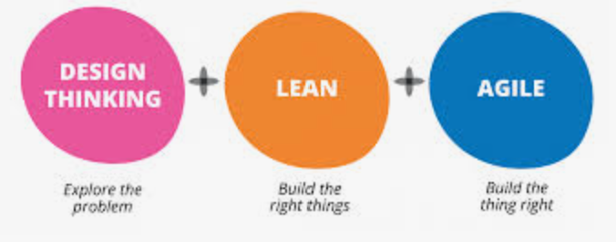
From last class…
Customer Centric , Design Centric Product D
Evolution of Human Centric design
Product Management
Integration of Design Thinking-Lean-Agile
Lean, Continuous Improved, Validated leadrning
Product LifeCycle Management

Slide 3
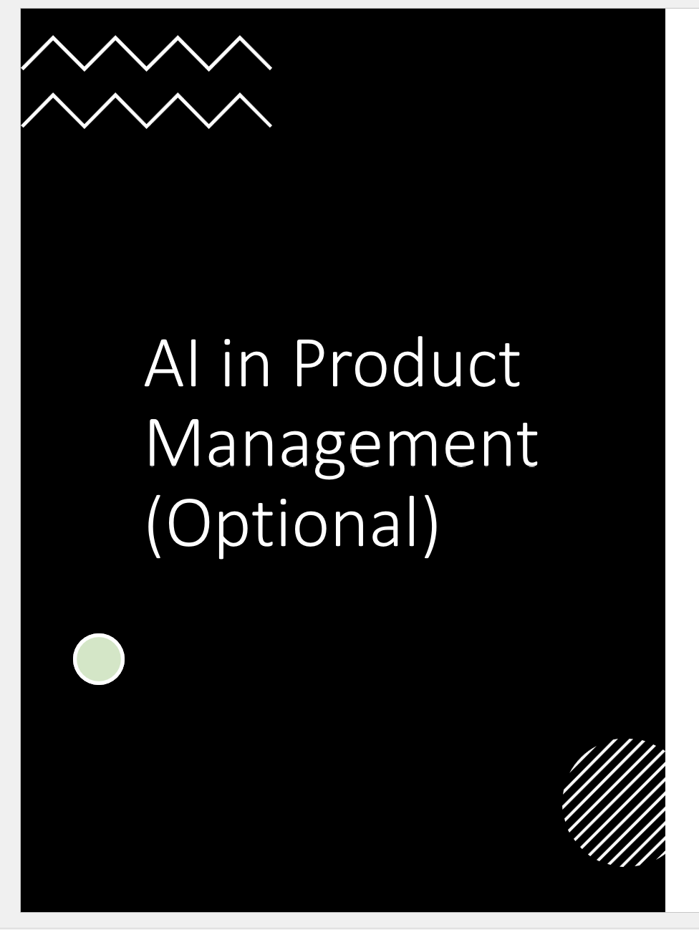
How to do Customer Centric Product Design (Optional)
OR
OCT
9/14 ; 9/21

Slide 4
How to do Customer Centric Product Design (Optional)
Intro
Understanding Customer Needs & Wants
Gathering & Managing Customer Reqmts
Market Research
Quantitative & Qualitative analysis
Product Requirement Document
Customer Study
Feature Study
Product Roadmaps of Competition
UX
Requirement Analysis / Review
Post Sale customer study
Product Feedback Gathering & study
User journey analysis
Conjoint Analysis
VOC Methods
(Interviewing techniques)
Customer value mapping
QFD

Slide 5
HOW to go about CCPD
Path/ Process Flow
VOC & Customer Insight Analysis
Customer Insight to Product /Process Specifications

Slide 6
Path to CCPD…
Program Charter
Customer Insight
Product That meets Customer/Market demand(Need & Want)
Mission
Scope
Target Mkt>Critical few Vs useful many…
Capture VOC
Qualitative Customer Insights
Quantitative Customer Needs &Wants
(Tools used Survey, Interview FGD, Customer mapping, Conjoint Analysis)
Identify Right Customer
(Tools Used: MultiGeneration Product plan, A3, MKT Segmentation, etc)
Prioritize Customer Needs from the insight
Prioritise the needs
Subgroup / bucketize the reqmt
Tools used KANO, Affinity Dgm, Str. Tree)
Relative priority of needs
Understand complementary and conflicting needs & technical parameters
Identify measurable parameters that ensures needs translation
(Tool : QFD)

Slide 7
Customer Insights Generation
Program Charter
Customer Insight
Product That meets Customer/Market demand(Need & Want)
Mission
Scope
Target Mkt>Critical few Vs useful many…
Capture VOC
Qualitative Customer Insights
Quantitative Customer Needs &Wants
(Tools used Survey, Interview FGD, Customer mapping, Conjoint Analysis)
Identify Right Customer
(Tools Used: MultiGeneration Product plan, A3, MKT Segmentation, etc)
Prioritize Customer Needs from the insight
Prioritise the needs
Subgroup / bucketize the reqmt
Tools used KANO, Affinity Dgm, Str. Tree)
Relative priority of needs
Understand complementary and conflicting needs & technical parameters
Identify measurable parameters that ensures needs translation
(Tool : QFD)

Slide 8
Different Perspectives, Different Goals
Buyers want all of the most desirable features at lowest possible price
Sellers want to maximize profits by: 1) minimizing costs of providing features 2) providing products that offer greater overall value than the competition

Slide 9
Demand Side of Equation
Typical customer/mkt research role is to focus first on demand side of the equation
After figuring out what buyers want, next assess whether it can be built/provided in a cost- effective manner

Slide 10
Products/Services are Composed of Features/Attributes
Credit Card: Brand + Interest Rate + Annual Fee + Credit Limit
On-Line Brokerage: Brand + Fee + Speed of Transaction + Reliability of Transaction + Research/Charting Options

Slide 11
Breaking the Problem Down
If we learn how buyers value the components of a product, we are in a better position to design those that improve success

Slide 12

How to Learn What Customers Want?
Ask Direct Questions about preference:
What brand do you prefer?
What Interest Rate would you like?
What Annual Fee would you like?
What Credit Limit would you like?

Slide 13
How to Learn What Is Important?
Ask Direct Questions about importances
How important is it that you get the <<brand, interest rate, annual fee, credit limit>> that you want?
Importance Ratings often have low discrimination:

Slide 14
VOC Methods
VoC Method | Product Development Use Case | Best Suited for ...
Lead User Analysis | Opportunity identification for specific markets Testing product concepts and identifying potential problems | Front-end innovation
Customer Advisory Council | Testing product use cases with key customers Identifying customer-specific needs | B2B customer feedback Buyer-supplier innovation opportunities
Participatory Design | Ideating solutions with customers Testing product design ideas | Customer co-development
Ethnography | Identifying unarticulated customer needs Understanding integration of products in customers’ daily life or workflow | Process-intensive products or services
Focus Group Discussion | Identifying stated needs of selected customer segments Honing ideas for market fit | Most industries or categories, except where customer is not end user
Customer Interviews | Identifying stated needs | Most industries and product categories
Surveys | Identifying stated needs Testing product-related hypotheses (e.g., hypotheses related to market segments; product features; or attributes, benefits or value proposition) | Most industries and product categories

Slide 15
Stated Importance's
Answers often have low discrimination, with most answers falling in “very important” categories
Answers sometimes useful for segmenting market, but still not as actionable as could be
Answers can be vague(e.g. respondents prefer low fees to high fees, higher credit limits to low credit limits)

Slide 16
What is Conjoint Analysis?
Research technique developed in early 70s
Measures how buyers value components of a product/service bundle
Dictionary definition-- “Conjoint: Joined together, combined.”
Marketer’s catch-phrase-- “Features CONsidered JOINTly”

Slide 17
How Does Conjoint Analysis Work?
We vary the product features (independent variables) to build many (usually 12 or more) product concepts
We ask respondents to rate/rank those product concepts (dependent variable)
Based on the respondents’ evaluations of the product concepts, we figure out how much unique value (utility) each of the features added
(Regress dependent variable on independent variables; betas equal part worth utilities.)

Slide 18
Why Conjoint?
More realistic questions: Would you prefer credit card . . . 0 Annual fee w or 10,000 Rs annual fee No Reward Points w 3% Cashback / rewards
If choose left, you prefer low annual fee. If choose right, you prefer reward points
Rather than ask directly whether you prefer Power over Fuel Economy, we present realistic tradeoff scenarios and infer preferences from your product choices
When respondents are forced to make difficult tradeoffs, we learn what they truly value

Slide 19
Qualitative – Quantitative analysis
Parameters | Qualitative | Quantitative
Concept | Aims to understand human behavior, preferences, and needs from an interviewee’s point of view. | Aims to understand human behavior, preferences, and needs from an interviewee’s point of view. Focuses on collecting facts about social phenomena
Objective | Concerned with discovering social phenomena, unconscious or conscious. Explores the psychological mechanisms via interaction with individuals or analyzing individual responses online. | Collects quantifiable data, which is easy to visualize. Measures the past and predicts the future. Help verify speculations and hypotheses made during qualitative research.
Methods to collect | Ethnographic research , Heuristic inquiry Online surveys (using Sentiment Analysis) User testing Focus groups Grounded theory | Digital analysis Technical analysis Online survey research Causal-comparative Correlational (Descriptive research)
Pros | Offers in-depth insights Budget-friendly Collects contextual data | Highly objective Easy to collect Easy to analyze and visualize Identifies trends
Cons | Not reliable in all cases Requires manual efforts (except for online surveys) Highly subjective | Lacks in-context data High on cost
When to use | To perform market research To add a human touch to your research To develop hypotheses | To perform market research To get general feedback To validate Hypotheses

Slide 20
Prioritize Customer Needs from Insights
Program Charter
Customer Insight
Product That meets Customer/Market demand(Need & Want)
Mission
Scope
Target Mkt>Critical few Vs useful many…
Capture VOC
Qualitative Customer Insights
Quantitative Customer Needs &Wants
(Tools used Survey, Interview FGD, Customer mapping, Conjoint Analysis)
Identify Right Customer
(Tools Used: MultiGeneration Product plan, A3, MKT Segmentation, etc)
Prioritize Customer Needs from the insight
Prioritise the needs
Subgroup / bucketize the reqmt
Tools used KANO, Affinity Dgm, Str. Tree)
Relative priority of needs
Understand complementary and conflicting needs & technical parameters
Identify measurable parameters that ensures needs translation
(Tool : QFD)

Slide 21
Affinity Diagram
Service
Product
Features
Product
Performance
Support
Other
Internal
Occupies 50% less space
Electrical and Mechanical performance of 2X Codes and Standards
Installable within 4 hour shift
Web ordering option
10% lower material costs
Simplified operation
Upgradeable without power down
20% fewer parts
Financing available
All features of current product
Average 10 year life
50% less manufacturing time
Modular upgrades
Less than 4 hours of operator training
Local channel support
-10 to 70 degree C range
Available in 12 months
Extended warranty
Interfaces to existing systems
10% less power consumption
Replaces existing GE and competitive products without equipment redesign
Long term service agreement
99% First Pass Yield
Remote Monitoring
Below acoustic noise level of facility
Can be sold by existing channels
24x7 application support
Platform for next 2 generations of planned releases
Idea/Need Statement
Group Title
Notes:
An affinity diagram is a tool for organizing customer requirements into basic themes or categories. It helps organize and summarize information in order to understand the type and priority of customer needs customer requirements.
Here we see an example representing the customer needs and desires of a hypothetical product. There are a large number of individual requirements (in the white boxes), gathered using the various tools described earlier, which have been organized into 5 categories. For example, the requirements of “50% less space,” “simplified operation,” “modular upgrades,” and several others have been gathered under the heading at the left, “Product Features”. Two other categories in the middle have themselves been gathered into a group, entitled “Service”.
The method of listing all low-level requirements, and gathering them into successively higher-level categories, is the essence of the affinity diagram method. The resulting structure shows the priority and relationships of the various requirements.

Slide 22
Structure Tree
Identify detailed needs and organize into more specific requirements . . .
Application support:
First Level
Second Level
Third Level
Knows about my application
Staff knowledgeable
Knows about my industry
Cares about my business
Provides answers to questions
Expert advice and consulting
Makes productivity suggestions
Staff proactive
Has 24x7 access to experts
Monitors my application for issues

Slide 23
Kano Model
Requirements Types and Definitions
Kano Diagram
Must Be:
(Dissatisfiers / Hygiene Factors)
Requirement that can dissatisfy but cannot increase satisfaction. Customer will probably not buy or use if absent.
Satisfaction
+
One-Dimensional:
(Satisfiers)
The more of these requirements (satisfiers) that are met, the more one is satisfied. More is always better and can determine if one product or service is used versus another.
Delighters
One- Dimensional
Delighters:
(Attractive Qualities/ WOW )
Service Dysfunctional
Service Fully Functional
If the requirement is absent it does not cause dissatisfaction, but it will delight customers if present. These differentiate the product or service from competition and drive value and price.
Must Be
Indifferent:
-
Customer is indifferent to whether the feature is present or not. These add unnecessary cost and risk to a program.
Dissatisfaction

Slide 24
Customer Insight to Product Requirement++
Program Charter
Customer Insight
Product That meets Customer/Market demand(Need & Want)
Mission
Scope
Target Mkt>Critical few Vs useful many…
Capture VOC
Qualitative Customer Insights
Quantitative Customer Needs &Wants
(Tools used Survey, Interview FGD, Customer mapping, Conjoint Analysis)
Identify Right Customer
(Tools Used: MultiGeneration Product plan, A3, MKT Segmentation, etc)
Prioritize Customer Needs from the insight
Prioritise the needs
Subgroup / bucketize the reqmt
Tools used KANO, Affinity Dgm, Str. Tree)
Relative priority of needs
Understand complementary and conflicting needs & technical parameters
Identify measurable parameters that ensures needs translation
(Tool : QFD)

Slide 25
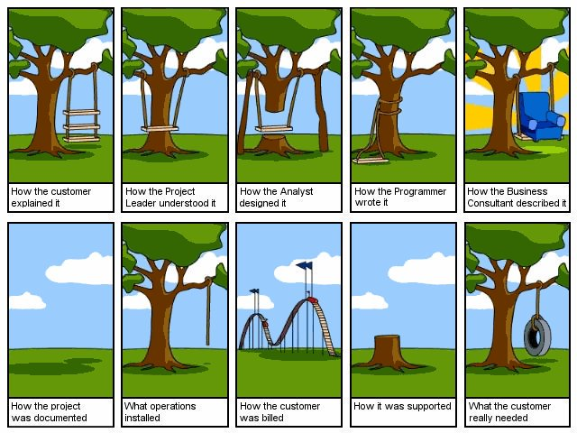
align technical details with customer requirements…
WHY do it… (M)
How to do it…(M)
Notes:
Image source : Twitter

Slide 26
QFD Origins…
Q – quality – how well we meet the needs of the customer,
F – a feature that defines all parameters related to the product, such as. size, shape, etc.,
D – how is shaped function of the quality of what is being done to meet the needs of the customer.
Detail Japanese name can be broken down into three words of which it is
– hinshitsu – signifying quality, characteristic, attribute,
– kino – denotes a function, a mechanism of action,
– tenkai – meaning the development, evolution.

Slide 27
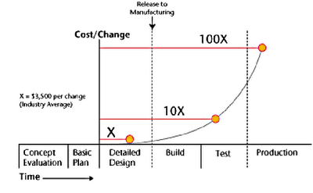
WHY QFD
1st Product
*
Using
QFD
No
QFD
Design Changes
Time
QFD Can Reduce Startup Time and Costs

Slide 28
Quality Functional Deployment
Conflict Resolution
Customer Importance
How important are the Customer WHATS to the Customer?
Target
Direction
HOW'S
How Do You Satisfy The Wants ?
Each Row represents a transfer function
H
L
L
M
WHAT'S
What Does The Customer Want
H
Relationship
Matrix
H Strong 9
M Medium 3
L Weak 1
Completeness
Check
M
M
L
H
L
M
M
L
H
L
M
How Much
Target Value and Units
Technical Importance
Used to Sort Matrix

Slide 29
When QFD
Complex Product Development Initiatives
Communications Flow Down Difficult
Expectations Get Lost
New Product Initiatives / Inventure
Lack of Structure or Logic to the Allocation of Development Resources.
Large Complex or Global Teams
Lack of Efficient And/or Effective Processes
Teamwork Issues
Extended Product Development Times
Excessive Redesign
Changing Team
Problem Solving, or Fire Fighting.

Slide 30
QFD Takeaways
A Quality Function Deployment (QFD) translates customer needs into detailed process/product requirements.
The QFD assists in narrowing the focus of the project by prioritizing actions according to their impact on the customer.
The QFD is a matrix which relates the customer wants to how we might satisfy those wants.
Each how is rated highly if it has a strong influence on a want
We multiply the how rating times the importance rating of the want to get the technical importance of the action.
The Goal of each QFD House is to Identify that subset of Xs which: if focused on as a group, allows us to Maximize the Opportunity of Meeting ALL the Customer Needs Simultaneously

Slide 31
Key Concepts
Customer Centric , Design Centric Product D
Evolution of Human Centric design
Product Management
Integration of Design Thinking-Lean-Agile
Lean, Continuous Improved, Validated leadrning
Product LifeCycle Management
Path/ Process Flow
VOC & Customer Insight Analysis (Conjoint)
Customer Insight to Product /Process Specifications (QFD)

Slide 32
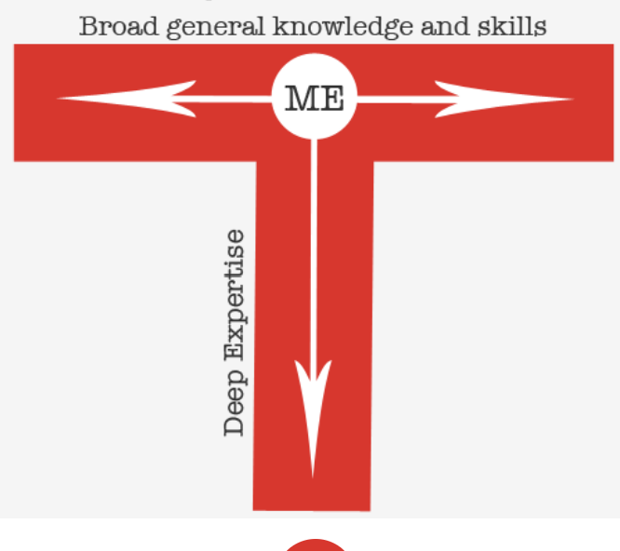
Team Exercise
Select a usecase to implement the learnings
Team of 5-6 students
can be broad or deep
Plan to either write a paper or presentation on your findings

Slide 33
Time permitting…

Slide 34
Conjoint Analysis Output
Utilities (part worths)
Importance's
Numeric values that reflect how desirable different features are: Feature Utility Vanilla 2.5 Chocolate 1.8 30 Rs 5.3 50 Rs 3.2 150 Rs 1.4
Measure of how much influence each attribute has on people’s choices
Best minus worst level of each attribute, percentaged: Vanilla - Chocolate (2.5 - 1.8) = 0.7 15.2% 30 Rs – 150Rs (5.3 - 1.4) = 3.9 84.8% ----- -------- Totals: 4.6 100.0%
Importances are directly affected by the range of levels you choose for each attribute

Slide 35
Market Simulations
- Make competitive market scenarios and predict which products respondents would choose - Accumulate (aggregate) respondent predictions to make “Shares of Preference” (some refer to them as “market shares”)
Ex: Predict market shares for 30Rs Vanilla cone vs. 50Rs Chocolate cone for Respondent #1: Vanilla (2.5) + 50Rs (3.2) = 5.7 Chocolate (1.8) + 30Rs(5.3) = 7.1 Respondent #1 “chooses” 30Rs Chocolate cone! Repeat for rest of respondents. . .

Slide 36
What Does The Customer Voice?
Understand The Types Of Customer Needs
What A Customer Verbalizes Depends On The Need
Unspoken
Unexpected
Unknown
Spoken
Measurable
Range of Fulfillment
Unspoken
Taken For granted
Basic
Perk
Sell
Work
Excitement
Performance
Basic
Has a
Provided
via a
Need
or
Task
CUSTOMER
Function
Function
Type
Need
Type
Voice
Type
UNDERSTAND HOW CUSTOMERS DO & DON’T VOICE WANTS
Notes:
The above chart illustrates the main differences between the so called “voice of the customer” and “what the customer voices”.
On the left we have a customer who has a need or task which is provided via some function. Functions are broken up into 3 types which each address a different type of customer need. These in turn illicit different forms of verbal information from the customer. Work functions address basic needs which the customer ASSUMES are in the product (e.g. 4 tires on a car). As a result the customer usually does not speak about them unless the need is NOT being met. Sell functions are like options on a car sticker, they are the high value “want to haves” that customer will communicate. Perk functions are excitement items that customer do NOT speak about because they do not know that they exist.

Slide 37
Kano Model
Customer Satisfaction
+
Delighters
One- Dimensional
Product/ Service Dysfunctional
Product/ Service Fully Functional
Must Be
-
Customer
Dissatisfaction

Slide 38
Critical information on customer needs (Today and Tomorrow)
Critical information on the competition?
How do we measure success, what our goals are
A determination of our priorities?
Critical information on Design details
What does the design “look” like? (Concept Generation)
How will the design meet the performance objective?
What Material will we use? What size is best?
Functional Requirements (HOW’s)
Customer Requirements (WHAT’s)
Importance
House Objectives:
Text
Customer Perception
Part Characteristics (HOW’s)
What does the Process look like? (Concept Generation)
How will the process meet the design characteristics?
What Equipment will we use?
What speed and temperature is best?
Functional Requirements (WHAT’s)
House Objectives:
Text
Manufacturing Processes (HOW’s)
Part Characteristics (What’s)
House Objectives:
Text
Design Elements, Characteristic’s
Targets, etc.
Process Variables (HOW’s)
Targets
Manufacturing Processes (What’s)
House Objectives:
Text
Process Steps & Parameters
Critical to Quality Characteristics
Targets
Key Manufacturing Processes
What Controls do we need in place to ensure Process Capability?
Etc.
Targets
Key Process Variables

